Slide 1
Swanzey Financial & Governance Review
15 years of budgets, votes, and patterns — and where it's heading
PublicLogic VAULT · June 2026 · Board Presentation

Slide 2
The verdict
Swanzey will fund operations but won't borrow; rewards saving, punishes bonds; budget support is eroding; and the administrator's office keeps turning over — while the town takes on a water utility.
• Can't borrow — facility bonds get majorities but die at the 3/5 wall (2024 & 2026)
• Budget on autopilot — +6–7%/yr; the default budget now equals the proposal
• Trust eroding — operating-budget support 81% (2011) → 57% (2025)
• Execution thinning — 3 town administrators in ~2 years; ousted incumbents; a land-use lawsuit

Slide 3
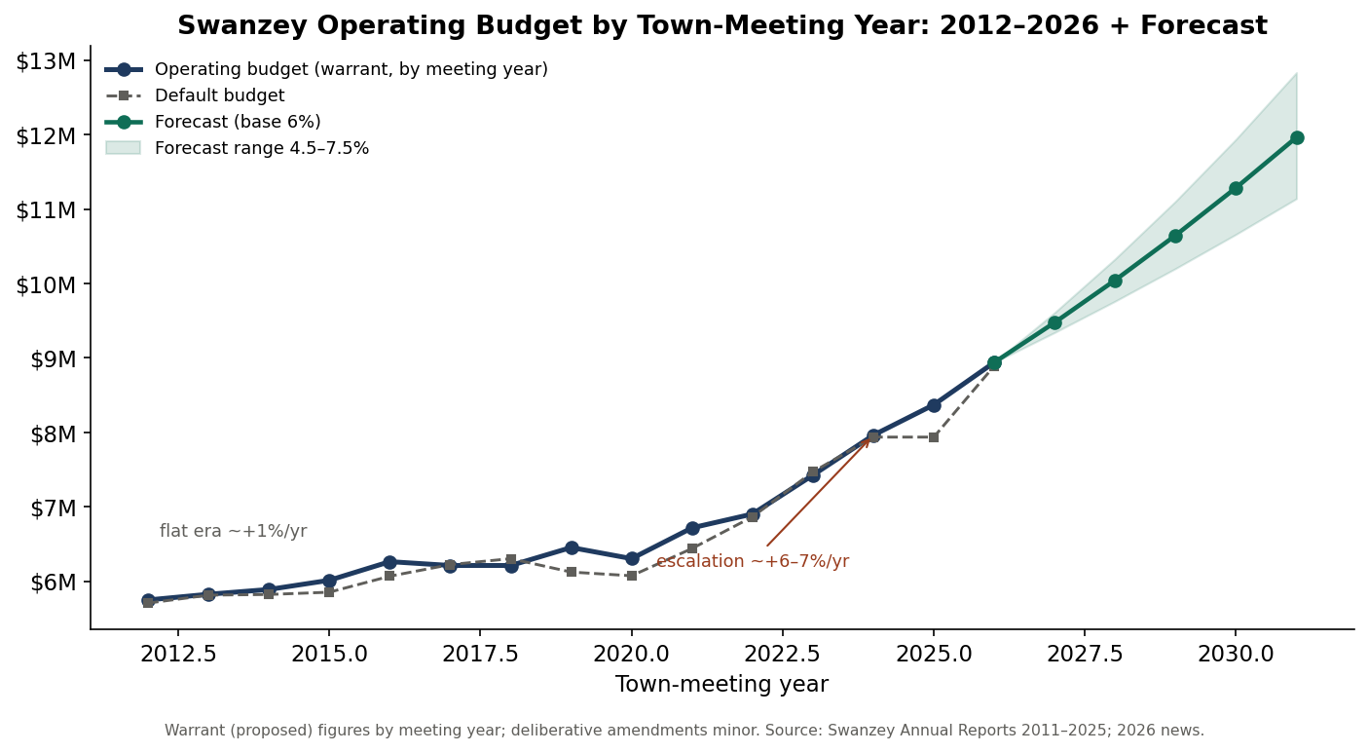
Budget: a high-growth regime

Slide 4
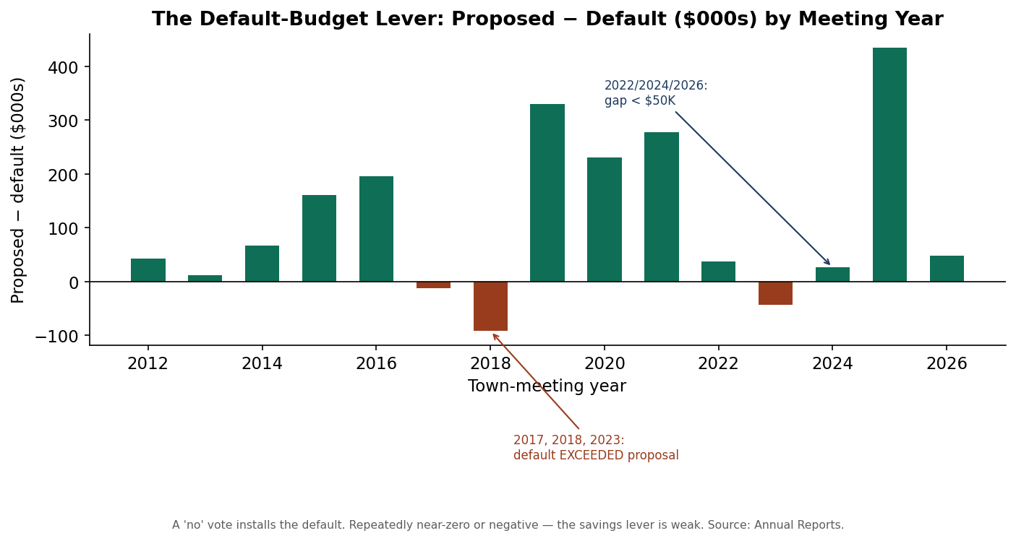
The 'vote no to save' lever is gone
By 2026 the default is within $47K of the proposal — and exceeded it in 2017, 2018 & 2023. Rejecting the budget changes almost nothing.

Slide 5
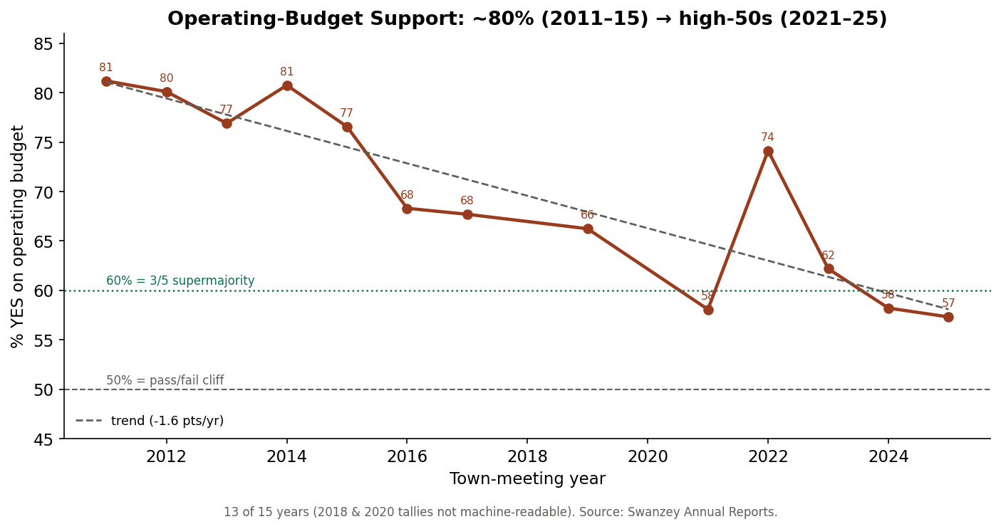
Budget support is sliding toward the cliff

Slide 6
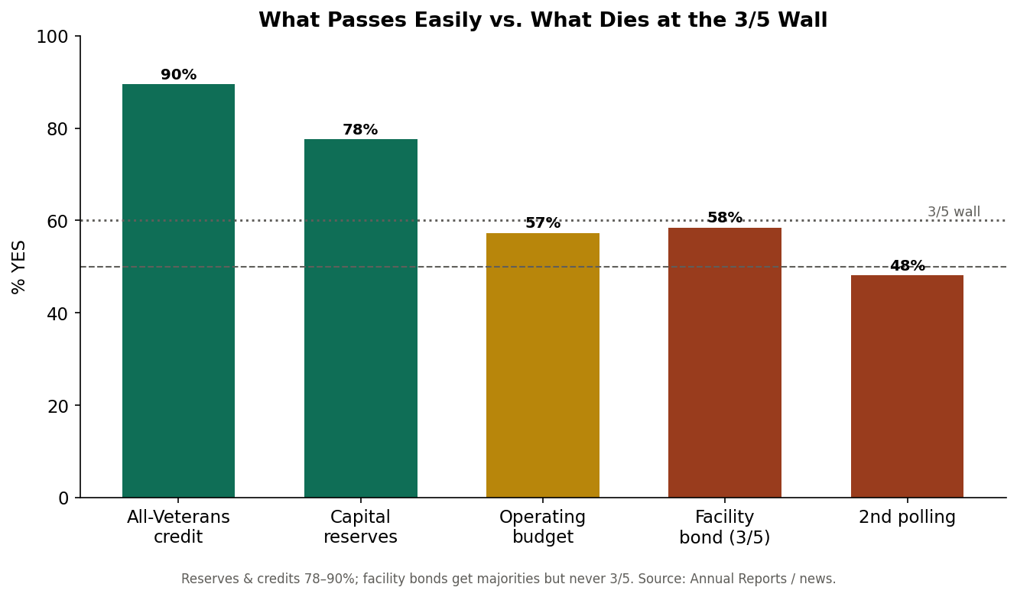
The real problem: the 3/5 wall
Not an opposition problem — a supermajority-threshold problem.

Slide 7
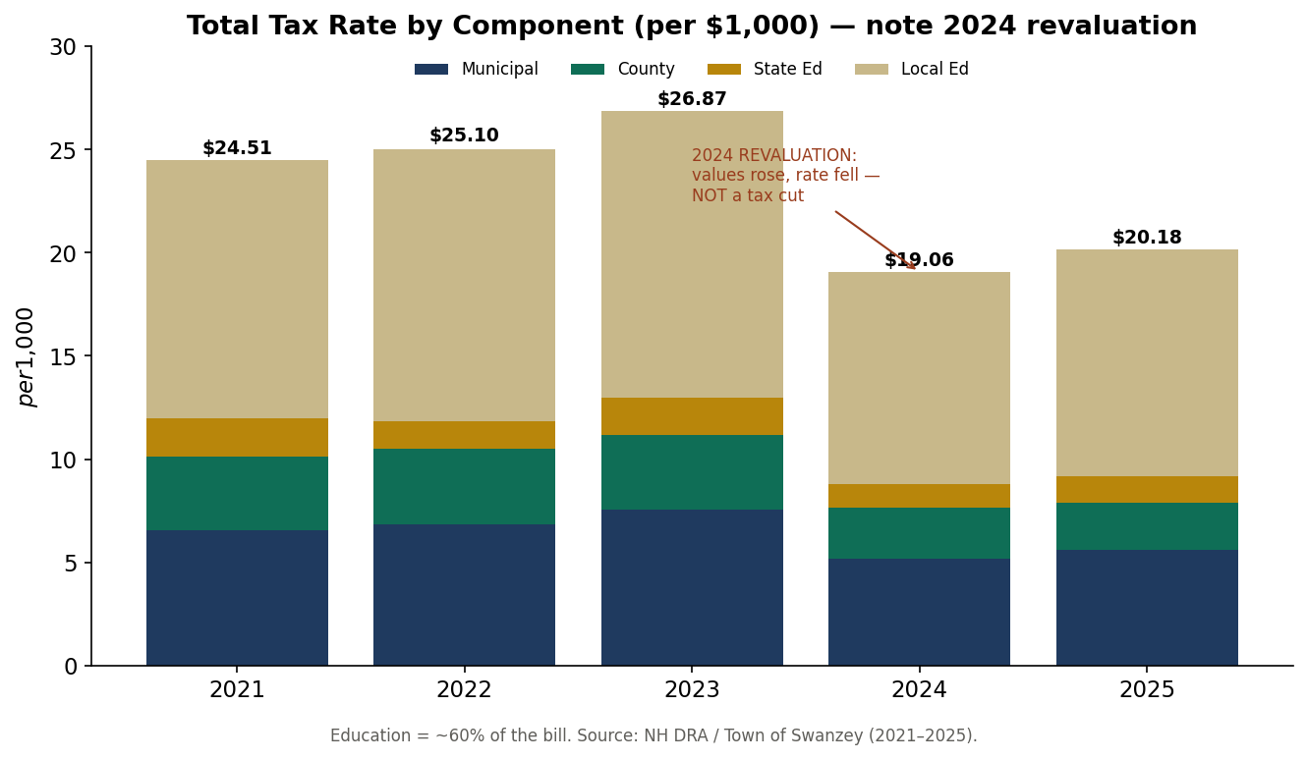
The 2024 'tax cut' was a revaluation

Slide 8
Their exact pains (ranked)
• P1 Administrative instability — 3 administrators in ~2 years (the master pain)
• P2 Capital paralysis — bonds die at 3/5
• P3 Eroding budget support — 81% → 57%
• P4 Dead default-budget lever — gap just $47K
• P5 Development litigation — Avanru senior-housing federal suit
• P6 Water-utility takeover — West Swanzey acquisition + SRF capital
• P7–P10 — bridge fights, governance churn, cost escalators, electoral volatility

Slide 9
Forecast
• Budget — base case crosses $10M by 2028–29, nears $12M by 2031
• Budget support — approaches the 50% line ~2030 (but default≈proposed, so low fiscal impact)
• Capital — any 3/5 bond keeps failing; reserve + state-aid + SRF is the only viable path
• Water — dominates the next 5 years; keep it on rates, not the tax base
• Wildcard — administrator stability gates every other outcome

Slide 10
The fix: restructure the money
Don't re-argue the failed bond — change how it's paid for.
• Make others pay first — 80% bridge aid (RSA 234); water via DWSRF rates + principal forgiveness; grants for ADA/roads
• Save, don't borrow — capital reserves need a simple majority, not 3/5; build the facility pay-go by 2031
• Smooth it out — phase deposits so the tax impact peaks small, then drops below today
• Already underway — 2025 water acquisition + SRF principal-forgiveness study prove the model works

Slide 11
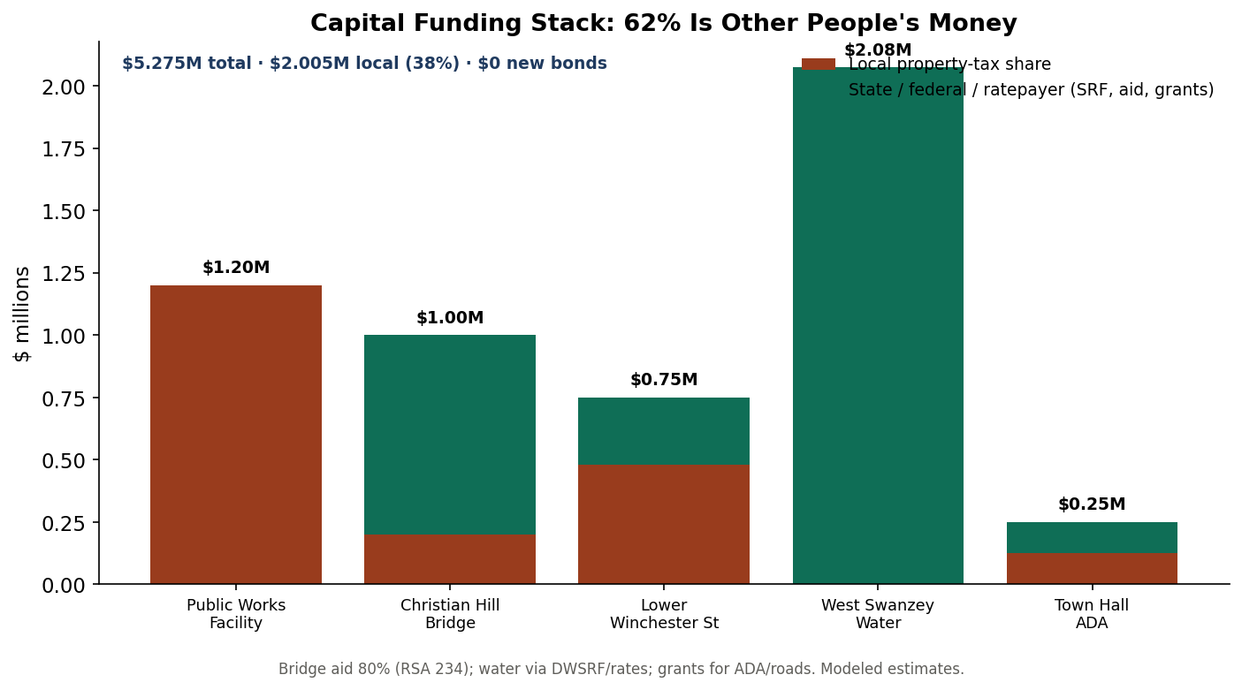
62% is other people's money
$5.3M of needs · $2.0M local · $0 new bonds · 0 supermajority votes.

Slide 12
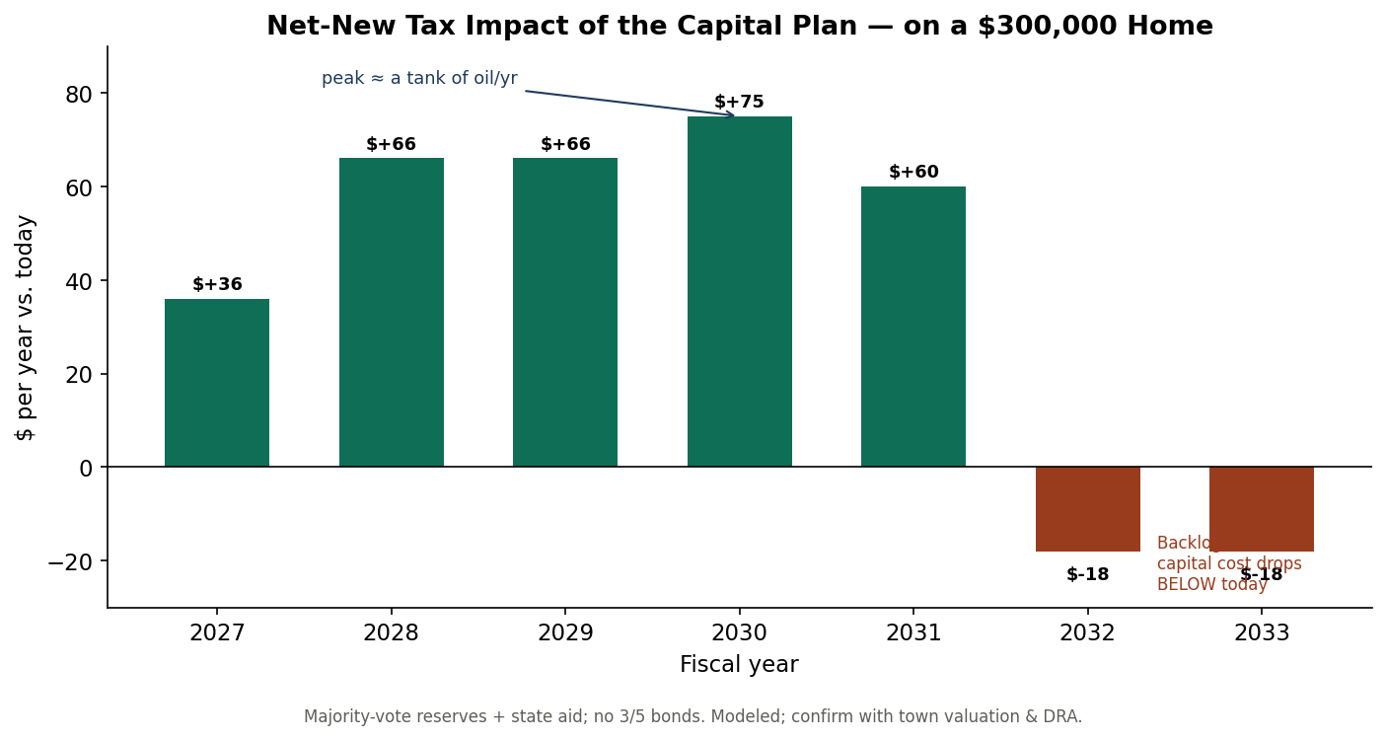
What the fix costs a $300k home
Peak ≈ a tank of oil/year — then below today, everything built.

Slide 13
Recommendations (sequenced)
R1 Stabilize the administrator — multi-year contract, clear lanes (do first)
R2 Reserve + state-aid + SRF capital — stop losing 3/5 bond votes
R3 Tell the truth on revaluation & budget — rebuild trust
R4 Publish a 6-year CIP — surprises become expectations
R5 Govern the new 5-member board — norms & onboarding
R6 Run water as an enterprise — rate study, DWSRF, asset mgmt
R7 De-risk land-use decisions — decide on criteria, with counsel

Slide 14
Stabilize the executive. Save, don't borrow.
Tell voters the truth.
Full model, findings, and sources accompany this deck.
Source: Town of Swanzey Annual Reports 2011–2025; NH DRA; local news. Forecasts modeled.

